Slide 1






CREDIT CARD FRAUD DETECTION USING STATE OF ART MACHINE LEARNING

Slide 2
OUR TEAM
Tharun (22R01A6651)
Varshith(22R01A6661)
Jaya Prakash(22R01A6663)
Shiva Sai (22R01A6684)

Slide 3
PROJECT OVERVIEW
This project aims to detect fraudulent credit card transactions using machine learning techniques.
We trained a model on real-world transaction data to classify whether a transaction is genuine or fraudulent, helping reduce financial losses and increase trust in banking systems.

Slide 4
INTRODUCTION
•Credit card fraud is a growing problem worldwide.
•Detecting fraud early helps protect both banks and customers from big financial losses.
•Using machine learning makes it faster and more accurate to find suspicious transactions.

Slide 5
PROBLEM STATEMENT
Fraudulent activities are escalating rapidly.
Immediate identification of suspicious transactions is vital to safeguard finances and preserve institutional credibility.
1.
2.

Slide 6
EXISTING SYSTEM DRAWBACKS
Traditional systems rely on static rules, making them easy for fraudsters to bypass.
1.
2.
High false positive rates disrupt genuine customer transactions.
3.
Poor adaptability to new and evolving fraud patterns.

Slide 7
NEW PROPOSED SYSTEM
1.
Random Forest Model: Used to classify fraudulent transactions.
2.
Data Features: Trained on key transaction and user behavior data.
3.
Better Accuracy: Reduces overfitting for reliable predictions.

Slide 8
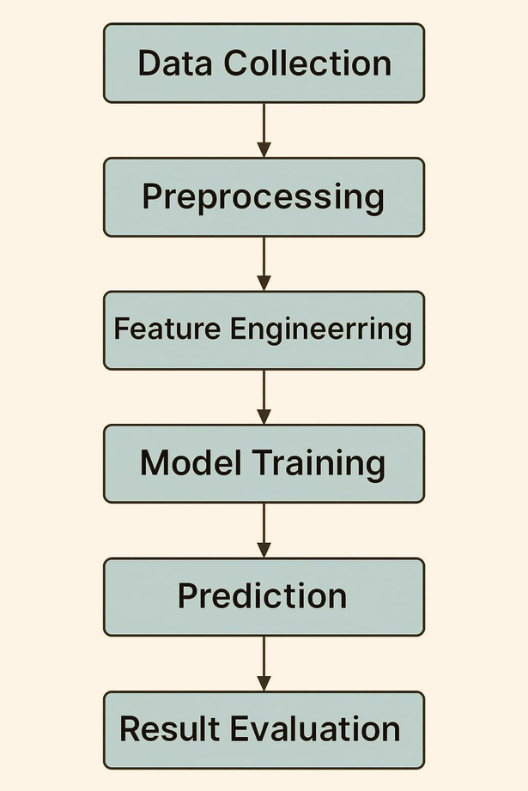
SYSTEM ARCHITECTURE
Data Collection
Preprocessing
Feature Engineering
Model Training
Prediction
Result Evaluation

Slide 9
MODEL SELECTION
🔹 Choosing the Right Model
Selected Random Forest Classifier because:
Handles imbalanced datasets effectively.
Reduces risk of overfitting.
Offers high interpretability and strong performance.

Slide 10
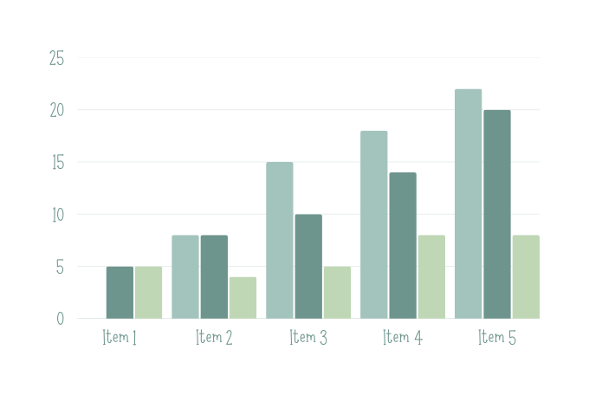
RESULT
High accuracy and strong recall achieved.
Confusion matrix revealed minimal false negatives.
Successfully detected majority of fraud cases.

Slide 11
PROPOSED SYSTEM ADVANTAGES
Higher accuracy and efficiency.
Scalable and adaptable to different use cases.
Enhanced user experience with faster processing.
Better data handling and security features.

Slide 12
CONCLUSION
Machine learning significantly enhances fraud detection capabilities.
Random Forest delivered strong initial results.
Advanced techniques offer opportunities for even better performance in the future.

Slide 13
THANK
YOU

